Slide 1
Education Departmental Meeting
3.30.17
Important Updates

Slide 2
Important Updates
Faculty are busily reviewing Upper Division Portfolios on Chalk & Wire.
For those taking the edTPA or any CBT assessment… it is important to remember that you need to indicate that our institution (Daemen College) should receive your score.
ADVISEMENT- Is right around the corner. Make an appointment ASAP. YOU MUST MEET WITH YOUR ADVISOR!!!!!!

Slide 3
CAEP accreditation facts… 3 new NYS*/CAEP requirements for cohorts will apply for 2017-2018.
3.0 GPA/QPA needed
SAT/ACT/GRE scores
Dispositional interviews- Charlotte Danielson model

Slide 4
Definitions from the CAEP accreditation site…
Cohort: A group of candidates admitted at the same time, e.g., a class entering in a fall semester.
Group average: The GPA and standardized test scores are averaged for all members of a cohort or class of admitted candidates. Averaging does not require that every candidate meet the specified score. Thus, there may be a range of candidates’ grades and scores on standardized tests.

Slide 5
Basic concept…

Slide 6
A bit more discrete….
Average is here!
Some are here
Some are here

Slide 7
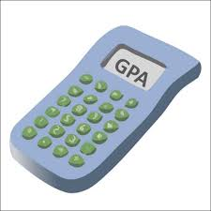
How to ensure your GPA/QPA meets the requirements
Understand the course requirements and organize your course work on a planner.
Know which assignments can be worked on over time. Organize your work day to maximize “hard” vs. “easy” tasks.
We know when you attempt to submit an assignment the “night before.” That is the grade you EARN!
Meet with Sabrina Fennel or Adriane Williams.
You may want to rethink your part-time work schedule if balance is a problem.

Slide 8
Make sure you prepare for the SAT/ACT/GRE/ALST if you have not taken them
Preparatory books and courses are available to you.
Make sure that you avail yourself to these resources. The proposed admission standards are on a sliding scale over time and INCREASE by year.
PRACTICE… PRACTICE… PRACTICE!!!

Slide 9
Dispositional Interviews
The department has implemented interviews based upon interrogatories that reflect the teaching competencies found in the domains of Charlotte Danielson
Her framework
The Framework for Teaching is a research-based set of components of instruction, aligned to the INTASC standards, and grounded in a constructivist view of learning and teaching. The complex activity of teaching is divided into 22 components (and 76 smaller elements) clustered into four domains of teaching responsibility:

Slide 10
4 Domains!!!
Domain 1: Planning and Preparation
+Domain 2: Classroom Environment
+Domain 3: Instruction
+Domain 4: Professional Responsibilities
https://www.danielsongroup.org/framework/
https://www.danielsongroup.org/books-materials/

Slide 11
NYSED has eliminated the ALST
https://www.nystce.nesinc.com/PageView.aspx?f=GEN_WhatTestsDoINeedToTake.html
New EAS - The EAS is being revised to include components of the ALST
EAS Review Timeline Recommendations
September 2017 – Framework & Item Review Conference
October 2017- Post Final Framework on NYSTCE Website
December 2017- Computer-based Field Testing
January 2018 – Test Implementation & First Operational Administration

Slide 12
Safety Nets and EXPIRATION dates…
https://www.nystce.nesinc.com/PageView.aspx?f=HTML_FRAG/GENRB_SafetyNet.html
Then
http://www.nystce.nesinc.com/PageView.aspx?f=HTML_FRAG/GENRB_SafetyNet_Tests.html
Handouts….

Slide 13
Teacher Projections…

Slide 14
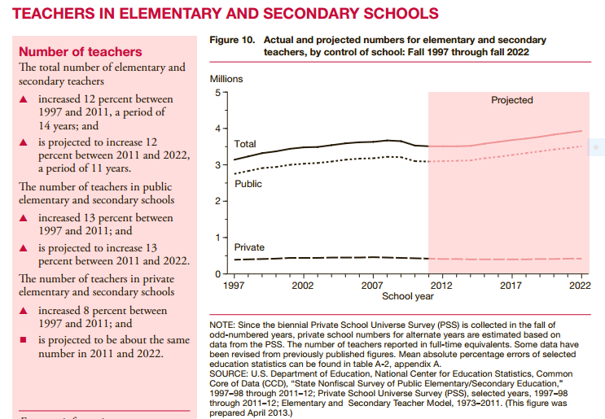

Slide 15
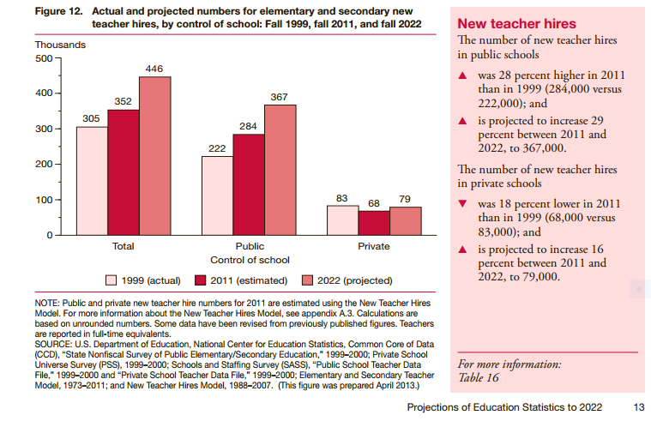

Slide 16
Questions???
Any questions?????

