Slide 1
June 1st, 2022 – May 31st, 2023

Slide 2
WHAT TO EXPECT FOR 2022
Medical Coverage Daemen University will continue to provide medical insurance through Univera for the 2022 plan year.
Signature Copay 1
Signature Deductible 3
Health Savings Account (HSA) Administered by LakeShore Savings Bank.
Daemen University will continue to offer an annual contribution to participating employees.
There has been an increase in the single and family maximum contribution limits.
Flexible Spending Account (FSA) Administered by Pro-Flex.
Daemen University will continue to offer a FSA to participating employees.
Health Care and Dependent Care options.
There is no increase to the maximum contribution limits for 2022.
Additional Coverage
**NEW Guardian will be the provider for: Life/AD&D, Voluntary Life, LTD, NYS DBL, Dental and Vision

Slide 3
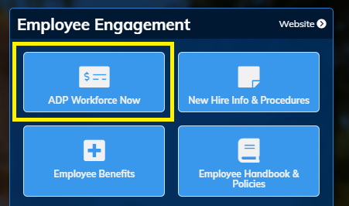
What’s New?
Electronic Open Enrollment
Elections for medical, dental, vision and life insurance will be completed through ADP’s electronic enrollment.
The election timeframe will be April 12th, 2021 through April 30th, 2021.
ADP Workforce Now can be accessed directly on the ‘MyDaemen’ homepage through single sign on.
HSA, FSA/DCA elections will require a paper application to be submitted through the secure Open Enrollment portal.

Slide 4
Signature Copay 1
Benefit Summary | In-Network | Out-of-Network
Deductible (embedded) | N/A | Individual: $1,000 Family: $2,000
Coinsurance | N/A | 20% coinsurance after deductible
Out-of-Pocket Maximum (embedded) | Individual: $6,350 Family: $12,700 | Individual: $5,000 Family: $10,000
In-Network Services
Prescription Coverage | $10 / $50 / $100
Primary Office Visit | $25 copay
Specialist Office Visit | $25 copay
Inpatient Hospitalization | $500 copay
Outpatient Surgery (facility) | $75 copay
Emergency Room | $50 copay
Urgent Care | $35 copay
Dependent Coverage | To age 26
4
BENEFITS 2022 LAWLEY | EMPLOYEE BENEFITS

Slide 5
Signature Deductible 3
Benefit Summary | In-Network | Out-of-Network
Deductible (true family) | Individual: $1,500 Family: $3,000 | Individual: $1,500 Family: $3,000
Coinsurance | 20% coinsurance after deductible | 40% coinsurance after deductible
Out-of-Pocket Maximum (embedded) | Individual: $4,000 Family: $8,000 | Individual: $5,000 Family: $10,000
In-Network Services
Prescription Coverage | $10 / $50 / $100 after deductible
Primary Office Visit | 20% coinsurance after deductible
Specialist Office Visit | 20% coinsurance after deductible
Inpatient Hospitalization | 20% coinsurance after deductible
Outpatient Surgery (facility) | 20% coinsurance after deductible
Emergency Room | 20% coinsurance after deductible
Urgent Care | 20% coinsurance after deductible
Dependent Coverage | To age 26
5
BENEFITS 2022 LAWLEY | EMPLOYEE BENEFITS

Slide 6
Lakeshore Savings
Requirements for enrolling in Signature Deductible 3 plan
All employees who enroll in the Signature Deductible 3 plan are required to open a Health Savings Account (HSA) with Lakeshore Savings.
For those employees who enroll in the HDHP and open an HSA with Lakeshore Savings, Daemen University will fund 100% of the deductible amount ($1,500 for single / $3,000 for family). The employer contribution will be funded quarterly.
Employees who want to contribute their own pre-tax money to an HSA through payroll deductions, must have an HSA account set up with Lakeshore Savings. Employee contributions will be funded with each pay period.

Slide 7
Free Preventive Health Services
Take control of your health, and work to improve it too.
Annual Routine Checkup | Immunizations
Cholesterol Screening | Mammography Screening
Colonoscopy Screening | Prostate Testing
Diabetes Screening | Well-Child Visit
High Blood Pressure Screening | Well-Woman Visit
7
BENEFITS 2022 LAWLEY | EMPLOYEE BENEFITS

Slide 8
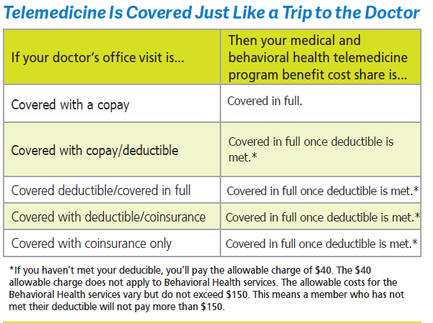
MDLIVE – TELEMEDICINE BENEFIT
Telemedicine for Medical and Behavioral Health Care
The Comfort of Care Available Anytime, Anywhere
All you need to do is activate it through your online member account and download the MDLIVE app.
When Do You Use Telemedicine?
Instead of going to urgent care or the emergency room for minor and non-life-threatening conditions
Whenever your primary care doctor is not available
If you live in a rural area and don’t have access to nearby care
When you’re traveling for work or on vacation
Nationwide Coverage (outside 39 county local network)
Univera Healthcare offers access to more than 876,000 practitioners
5,000 acute care facilities through the PHCS/MultiPlan system.
Members get the same in-network benefit when they receive care from a PHCS/MultiPlan participating provider throughout the United States.
8
BENEFITS 2022 LAWLEY | EMPLOYEE BENEFITS

Slide 9
PRESCRIPTION HOME DELIVERY
Home Delivery Pay only 2.5 copays for a 90 day supply with Prescription Home Delivery. The service is free to you and allows you to receive up to a 90 day supply by mail on time, every time. You can easily place your order online, by phone, or by mail.
Mail order options Wegmans Express Scripts
Your Medication will arrive to the address of your choice discretely packaged and appropriately packaged so your medication arrives safely and unaltered in any way.
9
BENEFITS 2022 LAWLEY | EMPLOYEE BENEFITS

Slide 10
WELLNESS REWARDS
With Wellness Rewards members can receive up to $250/$500* annually to be used on programs and services to help keep their family healthy
Whether saving time through…
healthy food home delivery services,
taking advantage of the 24/7 convenience of online fitness classes,
simply making sure the kids always have a fresh toothbrush,
help pay for things like youth sports fees,
gym memberships,
…members can use their Wellness Rewards in whatever way best fits their family’s needs and lifestyle.
Claiming rewards is easy
Wellness Rewards provides each family with up to $500* annually as a reward, just for being members. Members simply register online, submit upload proof of purchase for programs or services, and their Wellness Rewards debit card will be sent to them in the mail. The debit cards can be used anywhere, which gives members the flexibility of choosing the healthy programs that are right for them.
Wellness Rewards is included in all Univera Access medical plans.
*Only members with a spouse or domestic partner enrolled on their medical coverage will be eligible for the full $500 reward.
10
BENEFITS 2022 LAWLEY | EMPLOYEE BENEFITS

Slide 11
WELLFRAME
Delivering tailored patient support to address common drivers of readmissions
Univera Healthcare is dedicated to helping our members recover more easily, post-discharge. One step toward our goal is partnering with Wellframe’s health management solution.
The process is simple: Have your discharge staff introduce Univera Healthcare-insured patients to the Wellframe mobile app.
11
BENEFITS 2022 LAWLEY | EMPLOYEE BENEFITS

Slide 12
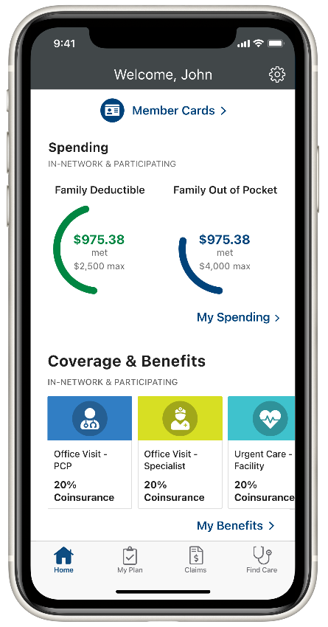
UNIVERA MOBILE APP
Get the Univera Mobile App
With your free Univera Mobile App you can now take your health plan with you for 24/7 access wherever you go.
View your member card
Track deductibles and out-of- pocket spending
Find a provider or medical facility
Access your benefits and claims information
12
BENEFITS 2022 LAWLEY | EMPLOYEE BENEFITS

Slide 13
EMPLOYEE MEDICAL PAYROLL DEDUCTIONS
2022 Bi-Weekly Payroll Deductions - Signature CoPay 1
Type of Coverage | Annual Salary $0,000-$39,999 | Annual Salary $40,000-$59,999 | Annual Salary $60,000-$79,999 | Annual Salary $80,000 and up
Single | $89.08 | $130.15 | $146.13 | $155.27
Family | $126.50 | $232.97 | $255.83 | $290.12
13
BENEFITS 2022 LAWLEY | EMPLOYEE BENEFITS

Slide 14
EMPLOYEE MEDICAL PAYROLL DEDUCTIONS
2022 Bi-Weekly Payroll Deductions - Signature Deductible 3
Type of Coverage | Annual Salary $0,000-$39,999 | Annual Salary $40,000-$59,999 | Annual Salary $60,000-$79,999 | Annual Salary $80,000 and up
Single | $6.32 | $56.74 | $72.15 | $80.96
Family | $8.20 | $106.68 | $128.73 | $161.75
14
BENEFITS 2022 LAWLEY | EMPLOYEE BENEFITS

Slide 15
EXAMPLE OF HOW A DEDUCTIBLE PLAN WORKS
Preventive Services | Other Services
 | Until deductible amount is reached | After deductible amount is reached
 | You pay a deductible up to a certain amount | Once the deductible amount is reached, you pay a copay or coinsurance
Health Insurance Company Pays 100%
You Pay
100%
You Pay
a Copay or Coinsurance
Health Insurance Company Pays a Percentage
Health Insurance Company Pays
You Pay
15
BENEFITS 2022 LAWLEY | EMPLOYEE BENEFITS

Slide 16
Health Savings Account

Slide 17
WHAT IS A HEALTH SAVINGS ACCOUNT (HSA)?
Health savings accounts (HSAs) are a great way to save money and efficiently pay for medical expenses. HSAs are tax-advantaged savings accounts that accompany high deductible health plans (HDHPs).
HSA ADVANTAGES
Triple Tax HSA Savings
Pre-Tax Funds are not subject to income tax
Tax-Deferred Money grows without being taxed
Tax-Free Withdrawals for qualified medical expenses
Ownership
Funds remain in the account from year to year
Security
Protect against high or unexpected medical bills
Affordability
Lower health insurance premiums
Flexibility
Pay for medical expenses or save for future needs
Control
You decide how to utilize your account
Portability
Your HSA is completely portable
17
BENEFITS 2022 LAWLEY | EMPLOYEE BENEFITS

Slide 18
Health Savings
WHO IS ELIGIBLE FOR A HEALTH SAVINGS ACCOUNT (HSA)?
Anyone who is:
COVERED BY a High-Deductible-Health-Plan (HDHP) (which would be Signature Deductible 3)
NOT enrolled in Medicare
NOT covered under other health insurance*
NOT claimed as a dependent on another person’s tax return
*other health insurance does not include: specific disease or illness insurance, accident, disability, dental care, vision care and long-term care insurance
18
BENEFITS 2022 LAWLEY | EMPLOYEE BENEFITS
Notes:
*Need to insert qualified HSA-Eligible HDP Plan names on this slide

Slide 19
CONTRIBUTING TO A HEALTH SAVINGS ACCOUNT (HSA)
You, your employer or a family member may contribute money to the HSA (either a lump sum payment or through payroll deductions).
SINGLE CONTRIBUTION
$3,650
HSA Year End Reporting
HSA Bank Statement
Includes contributions, payments to providers, interest earned, and fees.
8889 Tax Form
Needs to be completed with your year end tax return.
FAMILY CONTRIBUTION
2022 HSA maximum contribution Limits
$7,300
“Catch-Up” contribution
$1,000
Individuals who are age 55 and older can contribute an additional contribution annually
19
BENEFITS 2022 LAWLEY | EMPLOYEE BENEFITS

Slide 20
HEALTH SAVINGS ACCOUNT (HSA)
You can use money in your HSA to pay for any qualified medical expense. A full list is available on the IRS website, www.irs.gov in IRS Publication 502
QUALIFIED HSA EXPENSES
Copays or Deductibles
Select Insurance Premiums
Dental Care, Braces, Dentures
Vision Care, Glasses, Contacts
Diagnostic Tests & Devices
Medical Equipment
Doctor and Hospital Visits
Prescriptions
Non-Qualified Medical Expenses You will be required to pay income tax on the withdrawal, and you may also be required to pay another 20 percent tax, unless you make the withdrawal after you reach age 65, become disabled or after your death.
20
BENEFITS 2022 LAWLEY | EMPLOYEE BENEFITS

Slide 21
HEALTH SAVINGS ACCOUNT (HSA) BREAKDOWN
Employees who participate in the HSA will receive the following contribution from Daemen University:
2022 HSA CONTRIBUTIONS
Type of Coverage | Company HSA Annual Contribution | Employee HSA Contribution Limit | Combined Total Maximum Contribution
Single | $1,500 ($375 / Quarter) Jun * Sep * Dec * Mar | Can elect up to $2,150 | $3,650
Employee/Spouse Employee/Child(ren) Family | $3,000 ($750 / Quarter) Jun * Sep * Dec * Mar | Can elect up to $4,300 | $7,300
21
BENEFITS 2022 LAWLEY | EMPLOYEE BENEFITS

Slide 22
FLEXIBLE SPENDING ACCOUNT

Slide 23
FLEXIBLE SPENDING ACCOUNT (FSA)
A full list is available on the IRS website, www.irs.gov in IRS Publication 502
Eligibility
Health Care FSA Employees who enroll in Signature CoPay 1
Dependent Care FSA All employees
QUALIFIED FSA EXPENSES
Health Care (FSA) – Qualified medical, dental and vision expenses
Copays or Deductibles Dental Care, Braces, Dentures Diagnostic Tests & Devices Doctor and Hospital Visits | Medical Equipment Prescriptions Surgery Vision Care, Glasses, Contacts
Dependent Care (FSA) – qualified dependent expenses
Daycare, Nursery School, & Preschool Summer Day Camp | Before & After School Programs Licensed Child Care Provider (Need Tax ID #)
Care by a licensed provider for your spouse or a relative who is physically or mentally incapable of self-care and lives in your home.
FSA Recordkeeping
Always keep a copy of the Explanation of Benefits (EOB) and itemized medical and pharmacy receipts, as the FSA administrator reserves the right to substantiate expenses as well as the IRS.
23
BENEFITS 2022 LAWLEY | EMPLOYEE BENEFITS

Slide 24
FLEXIBLE SPENDING ACCOUNT (FSA) ANNUAL LIMITS
HEALTH CARE (FSA) limits
Minimum contribution
Maximum contribution
“Use-It or Lose-It Rule”
It is important to plan carefully because if you don’t use your FSA money by the end of the plan year, you will lose it.
$400
$2,850
Rollover
$500
FSA Recordkeeping
Always keep a copy of the Explanation of Benefits (EOB) and itemized medical and pharmacy receipts.
Dependent Care (FSA) Limits
$5,000
($2,500 if you are married and file separate returns)
24
BENEFITS 2022 LAWLEY | EMPLOYEE BENEFITS
Notes:
*With Minimum Contribution

Slide 25
DENTAL INSURANCE
DENTALGUARD PREFERRED
Allows you to visit any dentist of your choice but you pay less out-of-pocket when you choose a participating in-network dentist.
A Sample of Covered Services*
Preventive Care | Oral Exams | Fluoride Treatments
 | Cleanings | X-rays
 | Sealants
Basic Care | General Anesthesia* | Scaling & Root Planing
 | Fillings | Simple Extractions
 | Perio Maintenance Perio Surgery | Root Canal Surgical Extractions
Major Care | Bridges & Dentures | Inlays, Onlays, Veneers
 | Single Crowns & Implants
*This is a sample of covered services, please refer to your elected benefit summary for details on your specific dental plan coverage.
25
BENEFITS 2022 LAWLEY | EMPLOYEE BENEFITS

Slide 26
DENTAL INSURANCE
DENTAL PLAN
Allows you to visit any dentist of your choice but you pay less out-of-pocket when you choose a participating in-network dentist.
Benefit Summary | In-Network | Out-of-Network
Who Pays for Coverage | Daemen College and Employee
Preventive Services | 100% covered | 100% covered
Basic Services | 80% covered | 80% covered
Major Services | 60% covered | 60% covered
Orthodontia Services | 50% covered | 50% covered
Deductible | None
Annual Maximum | $1,000
Claim Payment Basis | Negotiated fee schedule
Ortho Lifetime Maximum | $1,000
Dependent Age Limit | To age 26
Bi-Weekly Payroll Deductions
Employee | $4.00
Family | $10.00
26
BENEFITS 2022 LAWLEY | EMPLOYEE BENEFITS
Notes:
With Rates

Slide 27
VISION INSURANCE
VSP SIGNATURE FULL FEATURE
Benefit Summary | In-Network | Out-of-Network
Who Pays for Coverage | Employee
Vision Network | VSP
Eye Exam | $10 copay | $50 allowance
Provider Frames | $130 allowance + 20% off balance | $48 allowance
Standard Vision Lenses | $25 copay | Allowance amount varies*
Elective Contacts | $130 allowance | $120 allowance
Medically Necessary Contacts | Covered in full after copay | $210 allowance
Dependent Age Limit | To age 26
Vision Frequency
Eye Exam | Once every 12 months
Frames | Once every 24 months
Lenses or Contact Lenses** | Once every 12 months
Bi-Weekly Payroll Deductions
Employee | $5.13
Family | $11.04
*Allowance amount based off lens type **Benefit includes coverage for glasses or contact lenses, not both
27
BENEFITS 2021 LAWLEY | EMPLOYEE BENEFITS

Slide 28
VISION INSURANCE
DAVIS SIGNATURE FULL FEATURE
Benefit Summary | In-Network | Out-of-Network
Who Pays for Coverage | Employee
Vision Network | Davis
Eye Exam | $10 copay | $50 allowance
Provider Frames | $135 allowance + 20% off balance | $48 allowance
Standard Vision Lenses | $25 copay | Allowance amount varies*
Elective Contacts | $135 allowance + 15% off balance | $105 allowance
Medically Necessary Contacts | Covered in full with prior approval copay does not apply | $210 allowance
Dependent Age Limit | To age 26
Vision Frequency
Eye Exam | Once every 12 months
Frames | Once every 24 months
Lenses or Contact Lenses** | Once every 12 months
Bi-Weekly Payroll Deductions
Employee | $3.66
Family | $7.87
*Allowance amount based off lens type **Benefit includes coverage for glasses or contact lenses, not both
28
BENEFITS 2021 LAWLEY | EMPLOYEE BENEFITS

Slide 29
VISION INSURANCE
IN-NETWORK COVERAGE COMPARISON
Network Summary | VSP | Davis
Eye Exam | $10 copay
Provider Frames | $130 allowance + 20% off balance | $135 allowance + 20% off balance
Standard Vision Lenses | $25 copay
Elective Contacts | $130 allowance | $135 allowance + 15% off balance
Medically Necessary Contacts | Covered in full after copay | Covered in full with prior approval copay does not apply
Dependent Age Limit | To age 26
Vision Frequency
Eye Exam | Once every 12 months
Frames | Once every 24 months
Lenses or Contact Lenses** | Once every 12 months
Payroll Deductions
Employee | $5.13 | $3.66
Family | $11.04 | $7.87
*Allowance amount based off lens type **Benefit includes coverage for glasses or contact lenses, not both
29
BENEFITS 2021 LAWLEY | EMPLOYEE BENEFITS

Slide 30
BASIC LIFE INSURANCE
Life insurance provides your family with a variety of support services designed to help them cope with both emotional and financial issues, even if you cannot be there.
Basic life Benefit Summary
Who Pays for Coverage | Daemen College
Benefit Amount | Flat benefit of $50,000
Guarantee Issue | $50,000
Benefit Age Reduction | 35% at age 65 50% at age 70
Additional Benefits | Waiver of Premium | Accelerated Benefit
 | Portability | Conversion
30
BENEFITS 2022 LAWLEY | EMPLOYEE BENEFITS
Notes:
*Need instructions to check if have AD&D, if not, need AD&D removed from 3 places

Slide 31
LIFE INSURANCE DEFINITIONS
Waiver of Premium – helps employees keep their life coverage if they’re disabled and unable to work for more than six months in a row.
Accelerated Death Benefit – enables the insured to receive a percentage of their death benefit when diagnosed as terminally ill, reducing the total death benefit by the amount received.
Portability – lets employees maintain their coverage, even if they leave their company.
Conversion – allows employees to convert all or part of their coverage to a permanent individual life policy if they leave their company, without Evidence of Insurability (EOI).
31
BENEFITS 2021 LAWLEY | EMPLOYEE BENEFITS

Slide 32
VOLUNTARY LIFE INSURANCE
VOLUNTARY LIFE PLAN
Life insurance provides your family with a variety of support services designed to help them cope with both emotional and financial issues, even if you cannot be there.
Voluntary life Benefit Summary
Who Pays for Coverage | Employee
Employee
Benefit Amount | Increments of $10,000 up to a maximum of $250,000
Guarantee Issue | $150,000 if under age 65, $50,000 ages 65 – 69, $10,000 70+
Spouse*
Benefit Amount | Increments of $5,000 up to a maximum of $125,000, not to exceed 50% of EE amount
Guarantee Issue | $10,000
Child(ren)*
Benefit Amount | Birth to 14 days: No benefit, 14 days age 20: $10,000 to age 26 if a full time student
Guarantee Issue | As Issued
Benefit Age Reduction | 35% at age 65; 50% at age 70
Additional Benefits | Waiver of Premium, Portability, Accelerated Benefit, Conversion
*In order to purchase life coverage for your spouse and/or child(ren), you must purchase life coverage for yourself
32
BENEFITS 2021 LAWLEY | EMPLOYEE BENEFITS

Slide 33
LONG TERM DISABILITY (STD) INSURANCE
LONG TERM DISABILITY (LTD) PLAN
Long Term Disability (LTD) coverage can help replace a portion of your income during the initial weeks of a disability to help you pay your bills and maintain your current lifestyle.
Long term disability (lTD) Benefit Summary
Who Pays for Coverage | Daemen College
Maximum Percentage | 66.67% of monthly earnings to a max of $8,000
Waiting Period | 90 days
Maximum Duration | Later of age 65 Social Security Normal Retirement Age (SSNRA)
Pre-Existing Limitation | 3 months look-back; 12 months covered
Disability Definition | 2 year own occupation
33
BENEFITS 2021 LAWLEY | EMPLOYEE BENEFITS

Slide 34
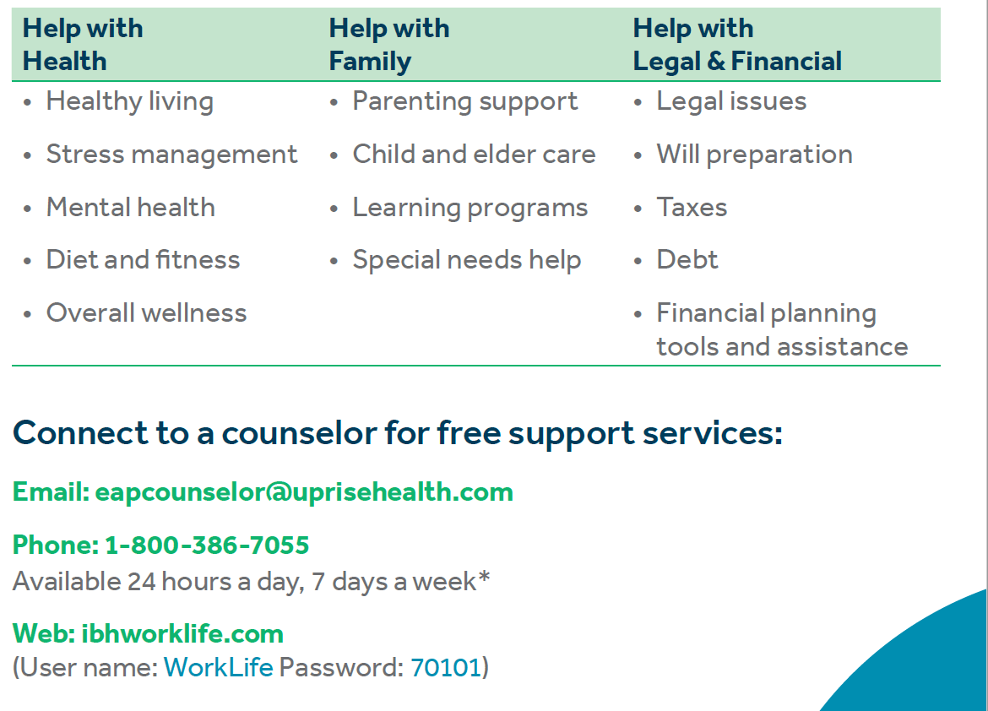
Employee Assistance Program
34
BENEFITS 2021 LAWLEY | EMPLOYEE BENEFITS

Slide 35
OPEN ENROLLMENT
NEXT STEPS
Review your benefit materials
Benefit summaries are available for all plans offered. Review the summaries before finalizing your plan choices. https://www.daemen.edu/about/working-daemen/employee-benefit-and-contact-information
ENROLL IN MEDICAL, DENTAL, VISION AND/OR LIFE insurance via adp open enrollment portal
Employees must electronically elect and/or confirm current elections through the ADP enrollment portal.
Complete pro-flex paper application to enroll in fsa/DCA (flexible spending account and/or dependent care account)
Employees newly electing, changing or keeping their current elections must confirm their annual election amount by completing the Pro-Flex Application.
FSA ProFlex Enrollment Form (Fillable PDF)
Upload ProFlex Enrollment Form to the Secure Form Portal:
https://my.daemen.edu/forms/secure_upload/form.php?group_id=17
{Insert Carrier Names}
ALL ELECTIONS MUST BE MADE BY: April 22nd, 2022
35
BENEFITS 2022 LAWLEY | EMPLOYEE BENEFITS

Slide 36
OPEN ENROLLMENT
NEXT STEPS
Complete lakeshore savings hsa (health savings account) paper application only if you are newly enrolling in the signature 3 deductible plan (hdp)
Newly enrolled employees in the Signature Deductible 3 Plan must complete required documents to open a LakeShore Savings Bank application in order to receive the Daemen contribution or make their own contributions through payroll deduction into their HSA account
Documents required to open an H.S.A. account with Lakeshore Savings Bank:
HSA Customer Verification Form (Fillable PDF)
W-9 Form (TIN Certification for HSA) (Fillable PDF)
ATM - Debit Card Request (HSA) (Fillable PDF)
Copy of non-expired State's Driver's License or US Passport
Upload all completed forms and copy of photo ID (Driver’s License/Passport) to the Secure Form Portal:
https://my.daemen.edu/forms/secure_upload/form.php?group_id=17
{Insert Carrier Names}
ALL ELECTIONS MUST BE MADE BY: April 22nd, 2022
36
BENEFITS 2022 LAWLEY | EMPLOYEE BENEFITS

Slide 37
Facebook | LinkedIn | Twitter Keep up to date with the latest from Lawley – Employee Benefits News, Compliance Updates, Insurance & Risk Trends, and more
www.lawleyinsurance.com

